Slide 1
Eric’s Earthquake Exploration
E³
Increased Understanding with Data science
Eric Hepp

Slide 2
Intensity and Distance
Epicenter
Epicentral Distance
Depth
Hypocentral Distance
Hypocenter
Notes:
Sources:

Slide 3
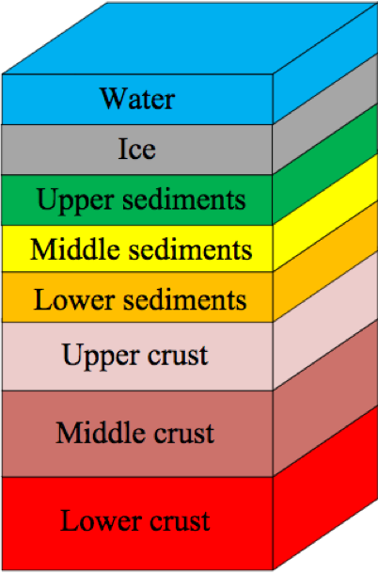
Intensity factors and Measurement
Contributing
Factors:
Magnitude
Distance
Depth
Crustal Properties
INTENSITY
GOAL: Predict it Better!
Methods to
Quantify:
Modified Mercalli (MMI)
Expert / Reviewed
May employ surface motion sensors
Modified and used in US from 1931
Community Decimal (CDI)
Crowd sourced from DYFI reports
Began 1991, in common use after 2001

Slide 4
Intensity Modeling: Validate CDI
Magnitude
Distance
Depth
Crustal Properties
INTENSITY
Modified Mercalli (MMI)
Expert / Reviewed
May employ surface motion sensors
Modified and used in US from 1931
Community Decimal (CDI)
Crowd sourced from DYFI reports
Began 1991, in common use after 2001
Model

Slide 5
Intensity Modeling: Add Detail
Magnitude
Distance
Depth
Crustal Properties
Model
INTENSITY
Modified Mercalli (MMI)
Expert / Reviewed
May employ surface motion sensors
Modified and used in US from 1931
Community Decimal (CDI)
Crowd sourced from DYFI reports
Began 1991, in common use after 2001

Slide 6
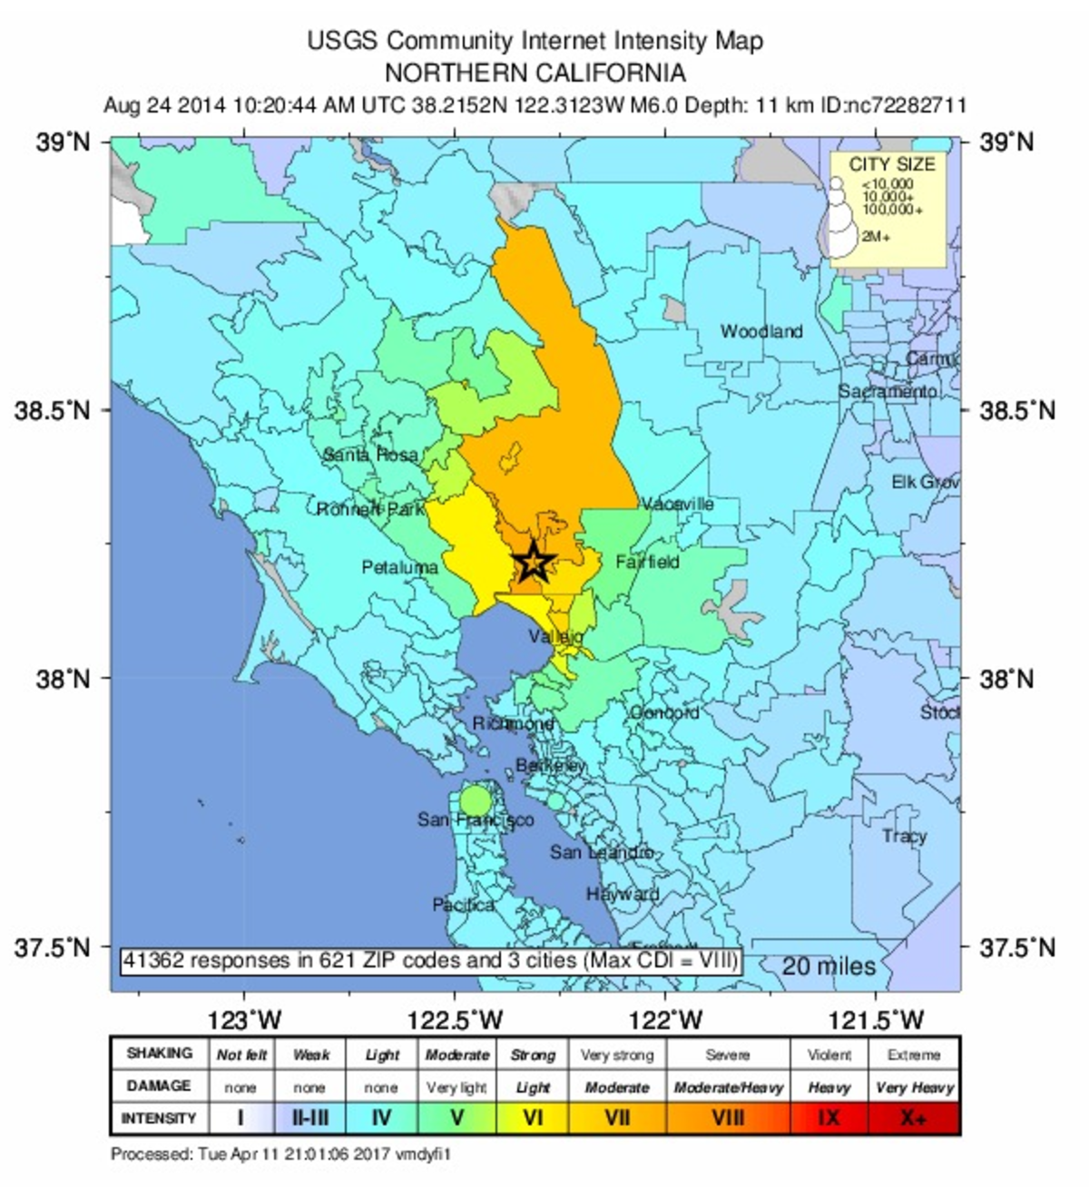
Data: How Much
Earthquakes from 1970 to mid 2017
Quakes
“DYFI” CDI
MMI
> 5
Earthquakes | Did You Feel It Intensity
117, 459
7287 | 273,499
4425 | 85,236
1206 | 55, 888

Slide 7
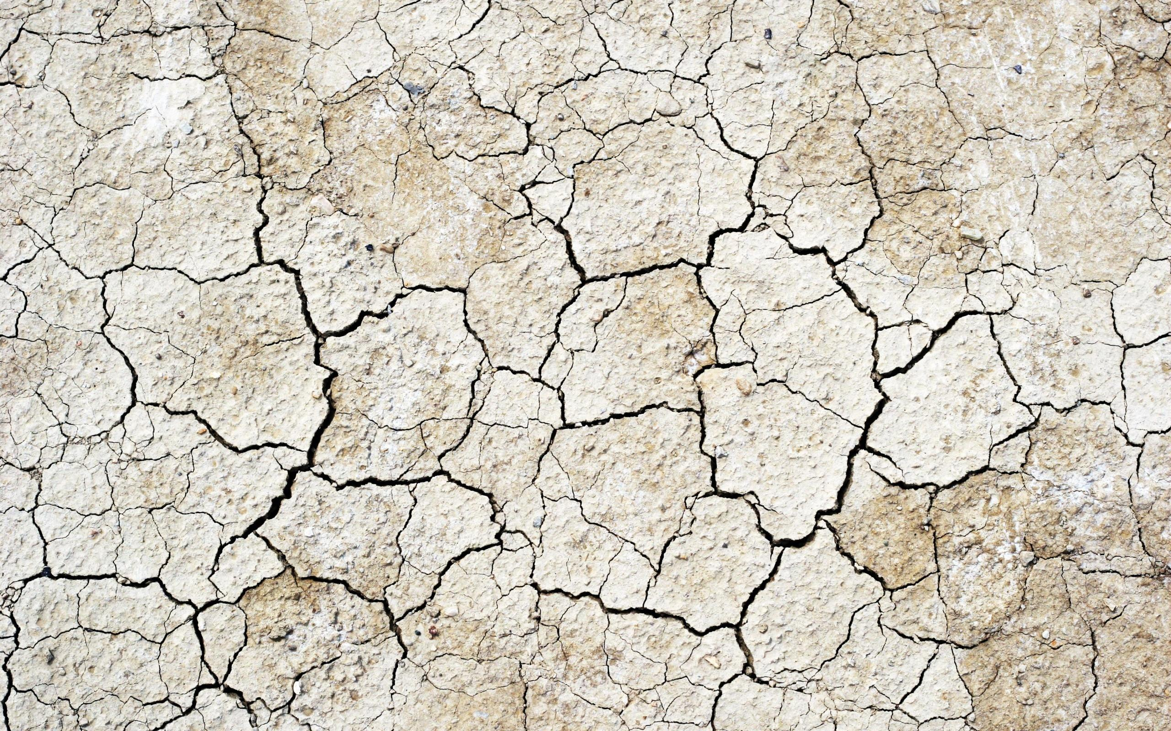
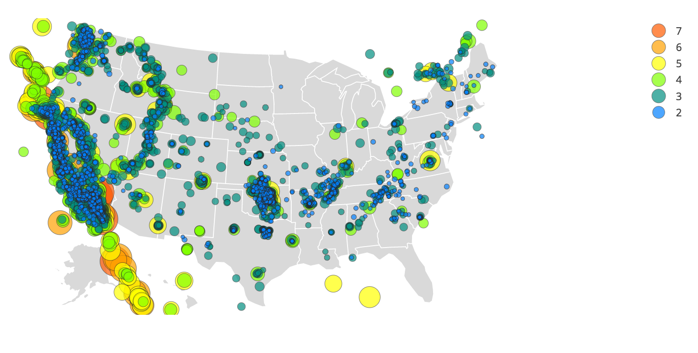
earthQuakes with DYFI / CDI data
Many small earthquakes
Few large earthquakes

Slide 8
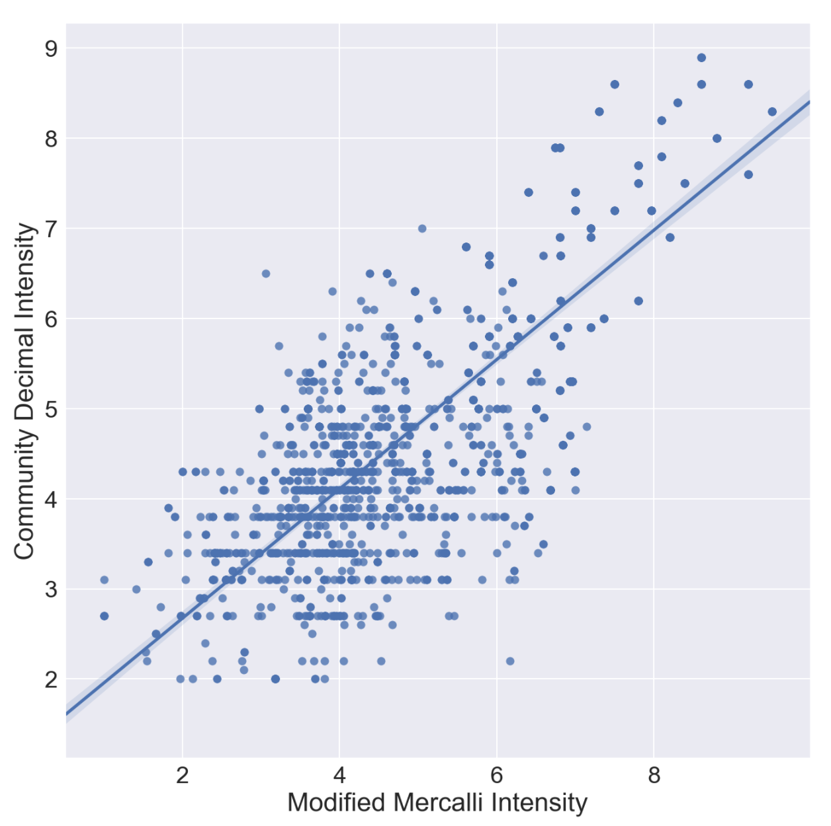
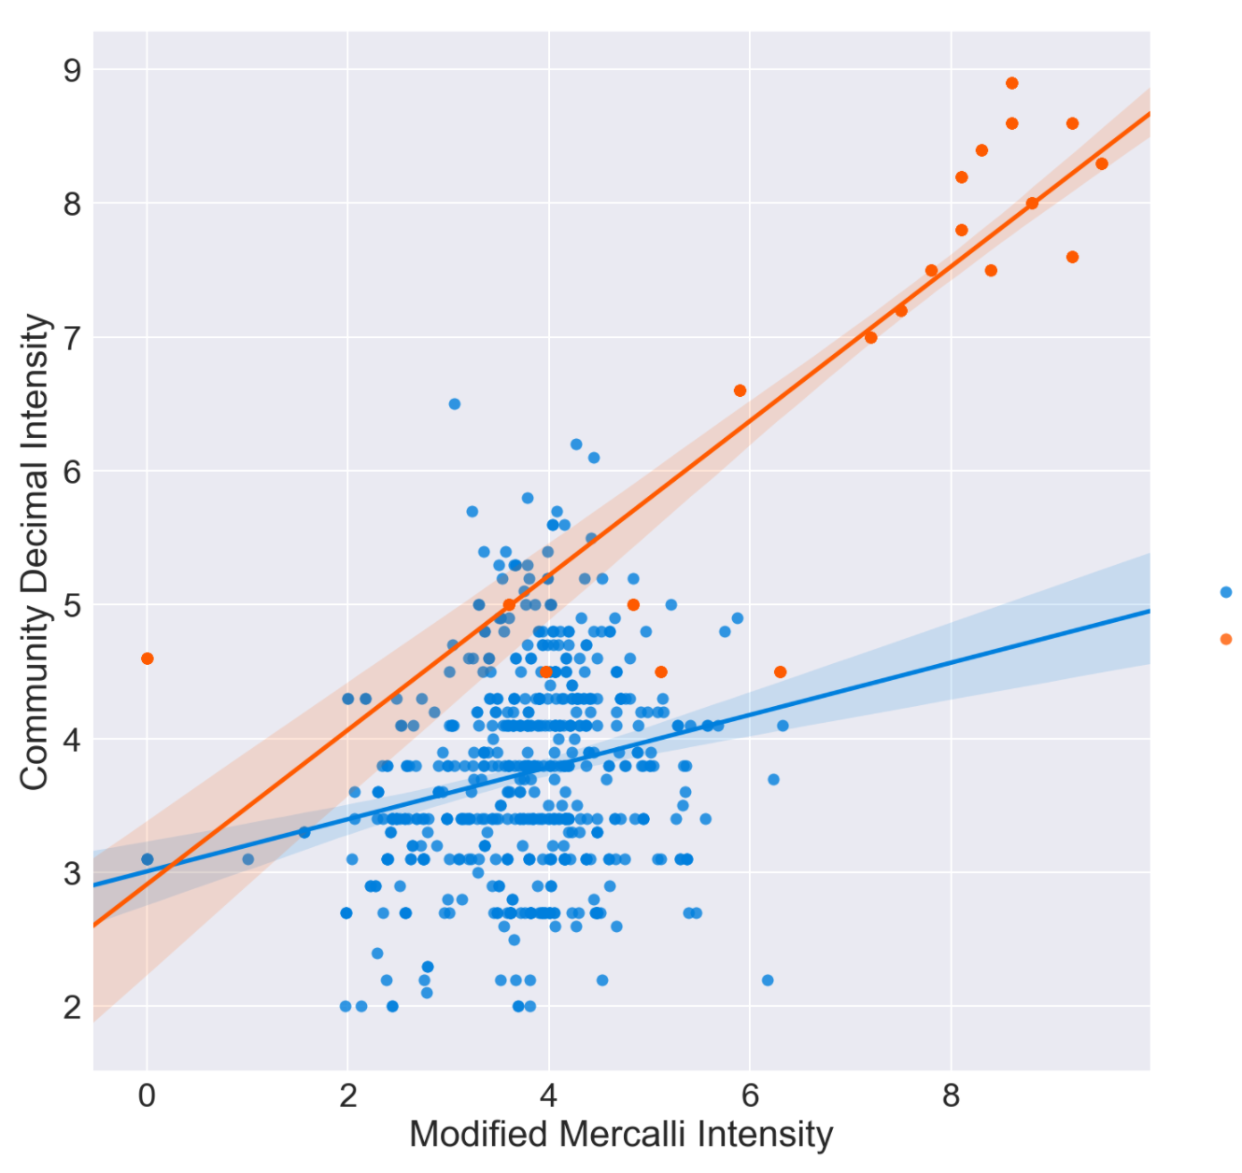
CDI / MMI comparison
Can one predict the other?
Maximum Intensity Data
Small Quakes
Large Quakes

Slide 9
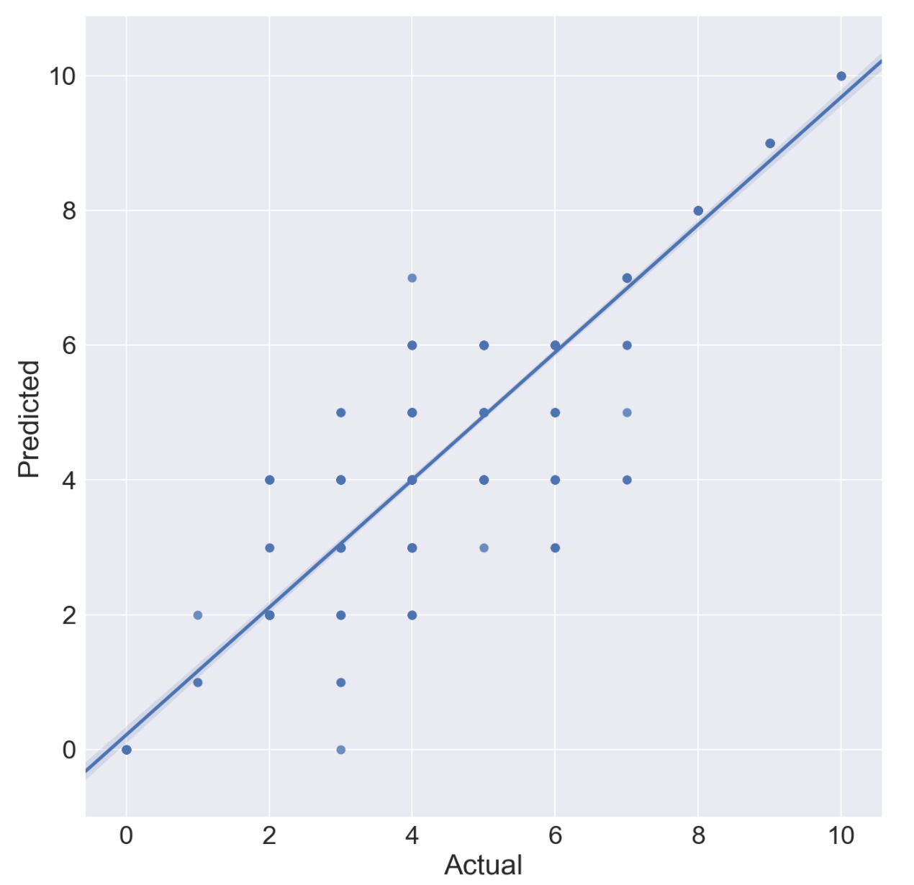
Predict ”Expert” MMI from “Citizen” CDI
Method: Decision Tree
Convert MMI to Integer Numbers
Use additional information:
US Region: West, Central, East
Depth of earthquake
Number of DYFI reports
(many are better than one)

Slide 10
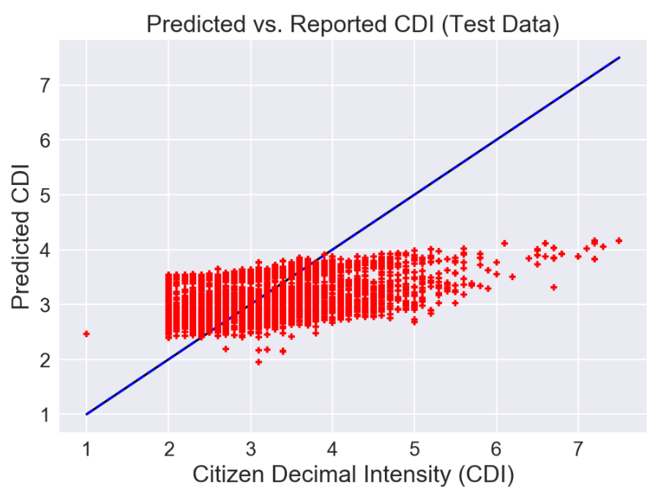
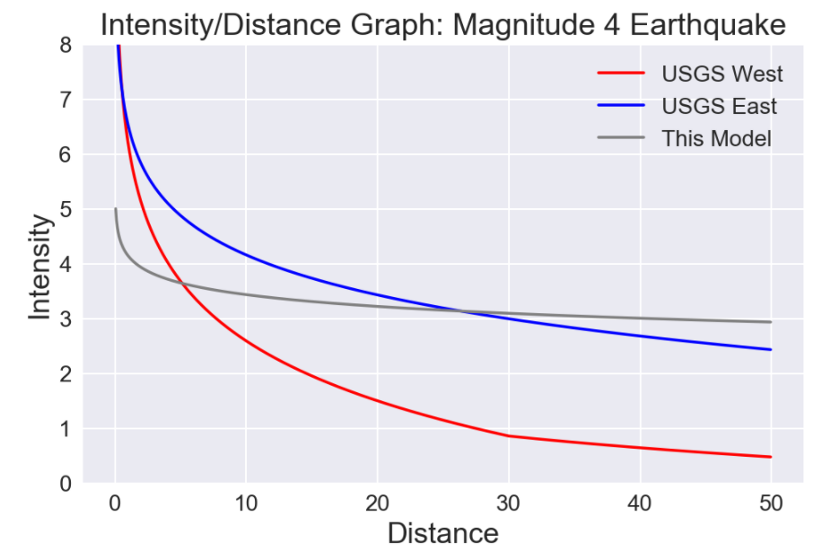
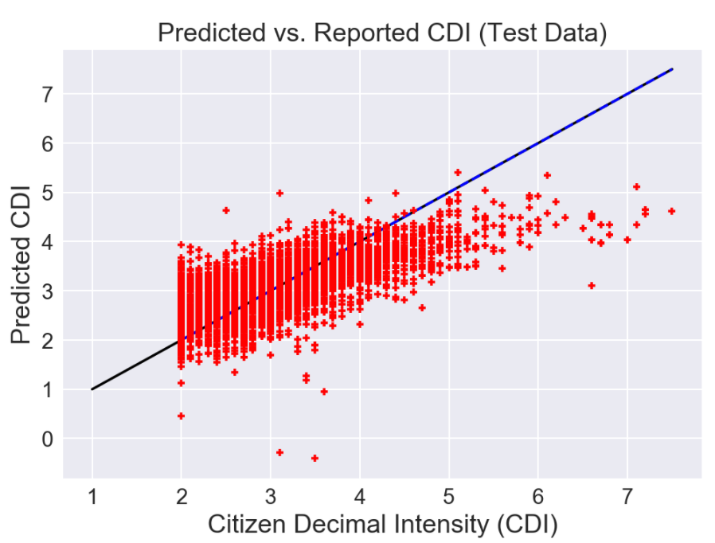
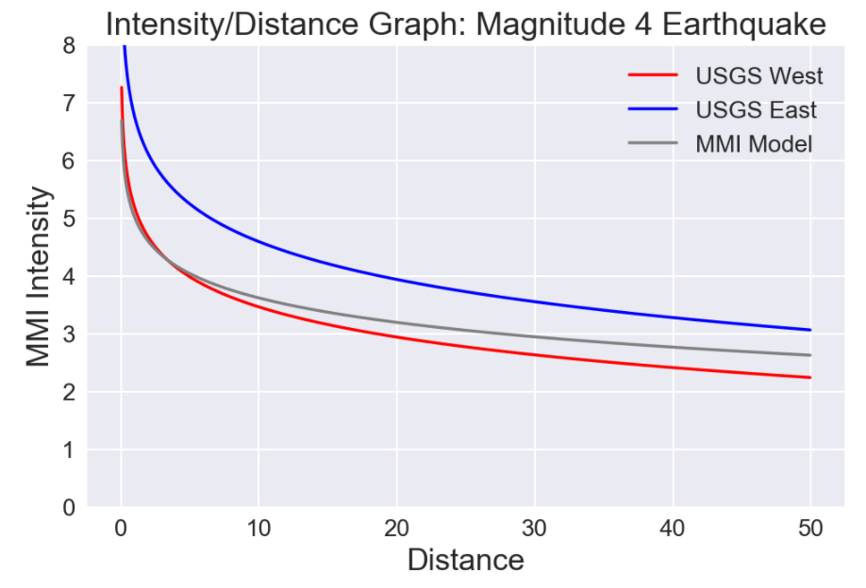
Predict CDI at Distance
Use Magnitude & Distance only
Only 18% of the difference between the average CDI earthquake intensity for all observations can be explained by this approach
45% of difference between average CDI intensity of all earthquakes and actual intensity observed can be explained by using:
Magnitude and Distance and …
Depth,
Crustal Density & Thickness
Method of computing magnitude

Slide 11
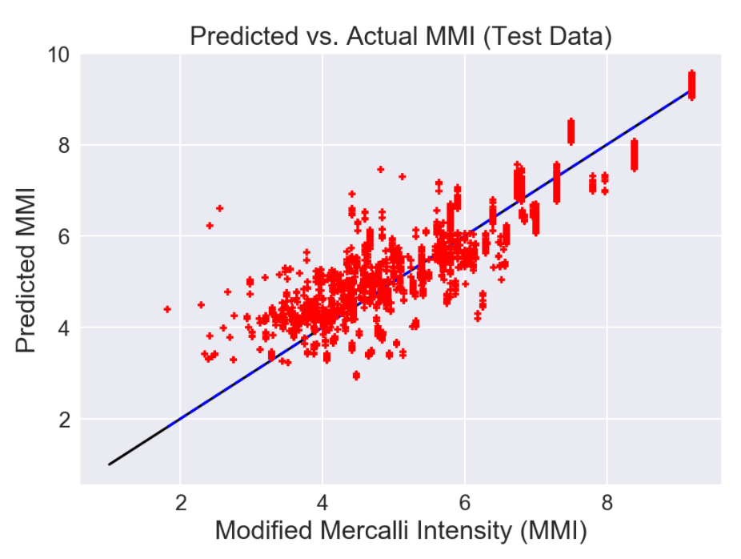
Predict MMI from
Magnitude and Distance
Modified Mercalli Intensity (MMI)
This explains 91% of the difference between average MMI intensity of all earthquakes and actual intensity observed –
… and only magnitude and distance were used!
What’s up with this?
Data reported and reviewed by experts
Reported over longer period of time
Includes larger proportion of high magnitude earthquakes

Slide 12
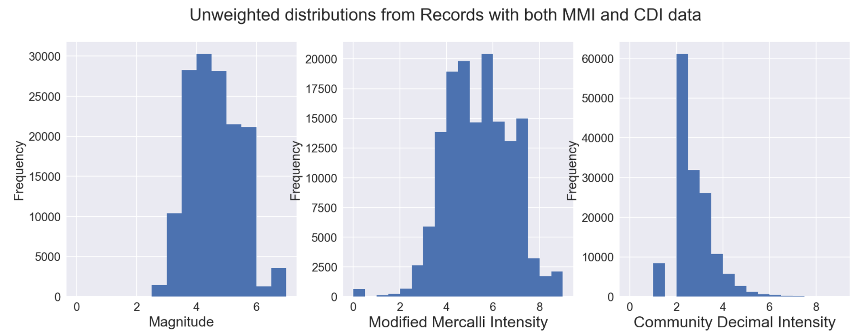
Community Decimal Intensity Usefulness
Conclusion: Based on this dataset, CDI is useful as initial evaluator; it is cheap and easy to collect data.
It can be a reasonable predictor of MMI when considering the maximum values of each which occur near earthquake epicenter, especially when combined with additional factors of depth and region.
CDI can be predicted from magnitude and distance when enhanced by additional non-traditional factors.
There is a Problem:
Many small earthquakes
Few large earthquakes
And a Bigger Problem:
CDI intensities are seemingly lower in intensity than MMI intensity
Either reporters are reluctant to report more significant effects, or
Process for calculating CDI from DYFI reports is flawed

Slide 13
Data Sources
References
USGS: Common Catalog
Aggregation of Earthquake Events from many reporting agencies
Includes “Did You Feel It,” CDI data, MMI and Magnitude
LLNL: Crust 1.0 Model
Crustal Boundary and Density Data
Wald, David J. (2011). USGS “Did You Feel It?” Internet-based macroseismic intensity maps. ANNALS OF GEOPHYSICS, 54.6
Oklahoma Example: Matthew Schroyer paper
Crowdsourced Geographic Information use in Govt.

Slide 14
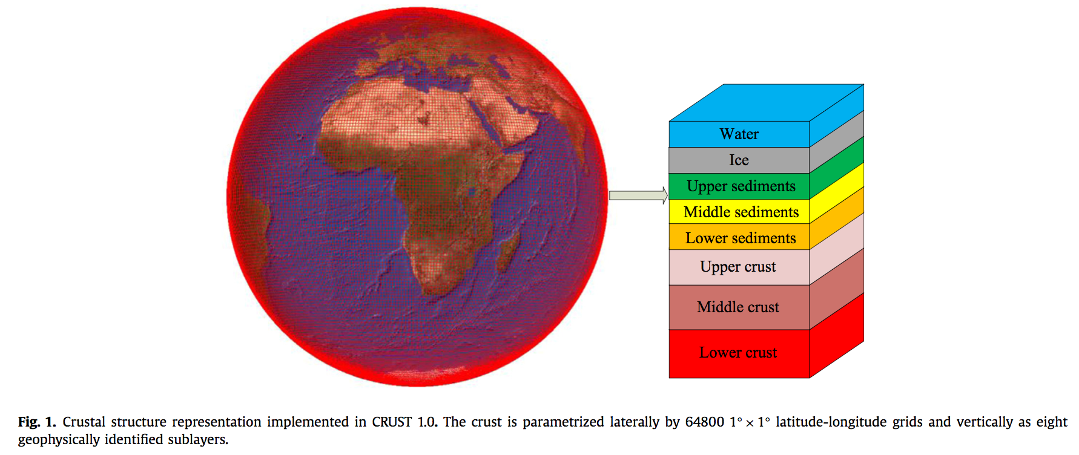
Global Crustal Model
Zhu, L.F., Pan, Z., Sun, J.Z., (2016). Visualization and dissemination of global crustal models on virtual globes, Computers and Geosciences v90, Part A, 34-40. Elsevier, https://doi.org/10.1016/j.cageo.2016.01.015
https://igppweb.ucsd.edu/~gabi/crust1.html#visualization

Slide 15
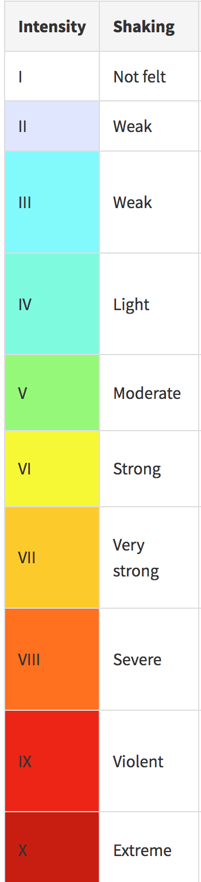
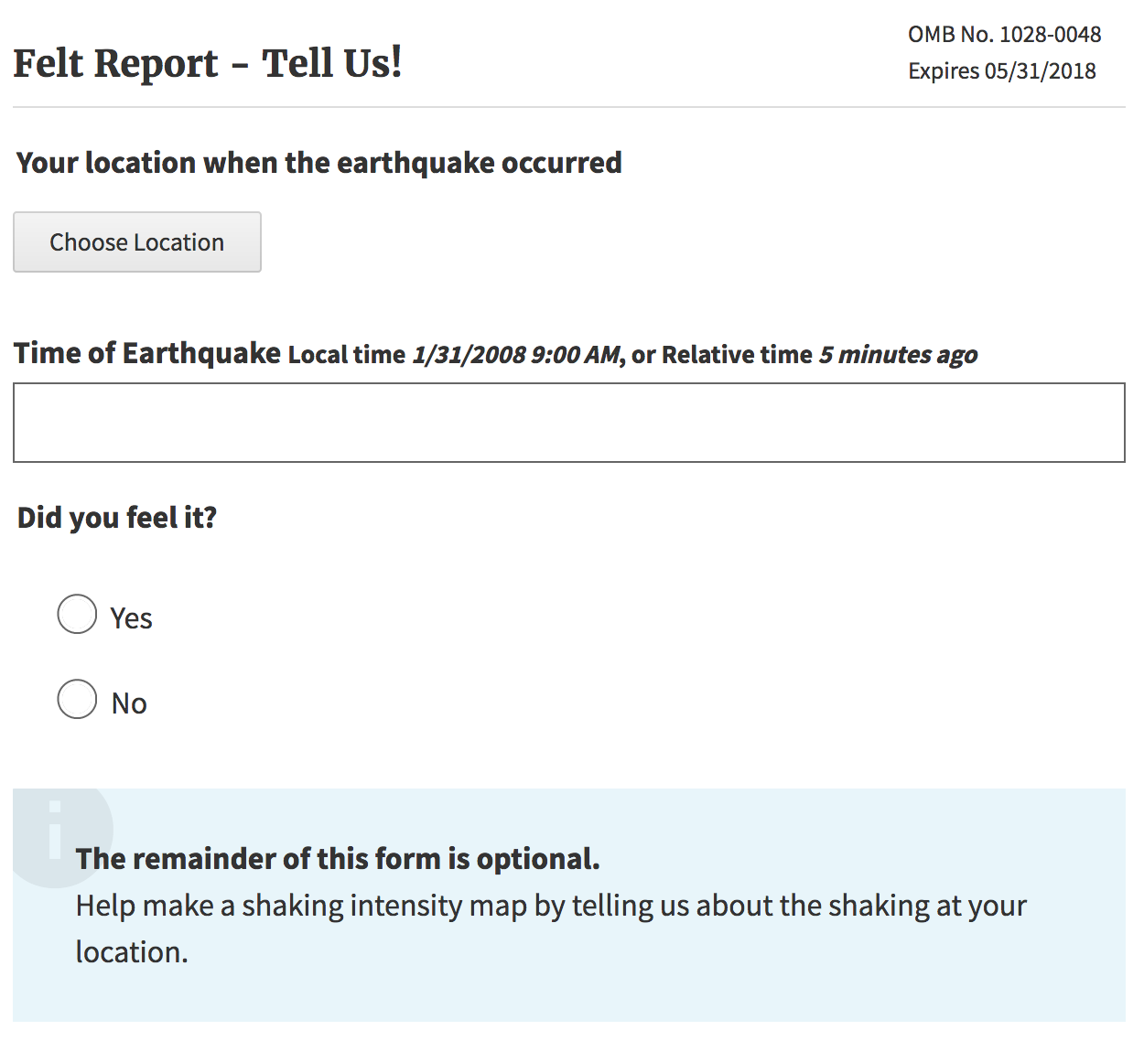
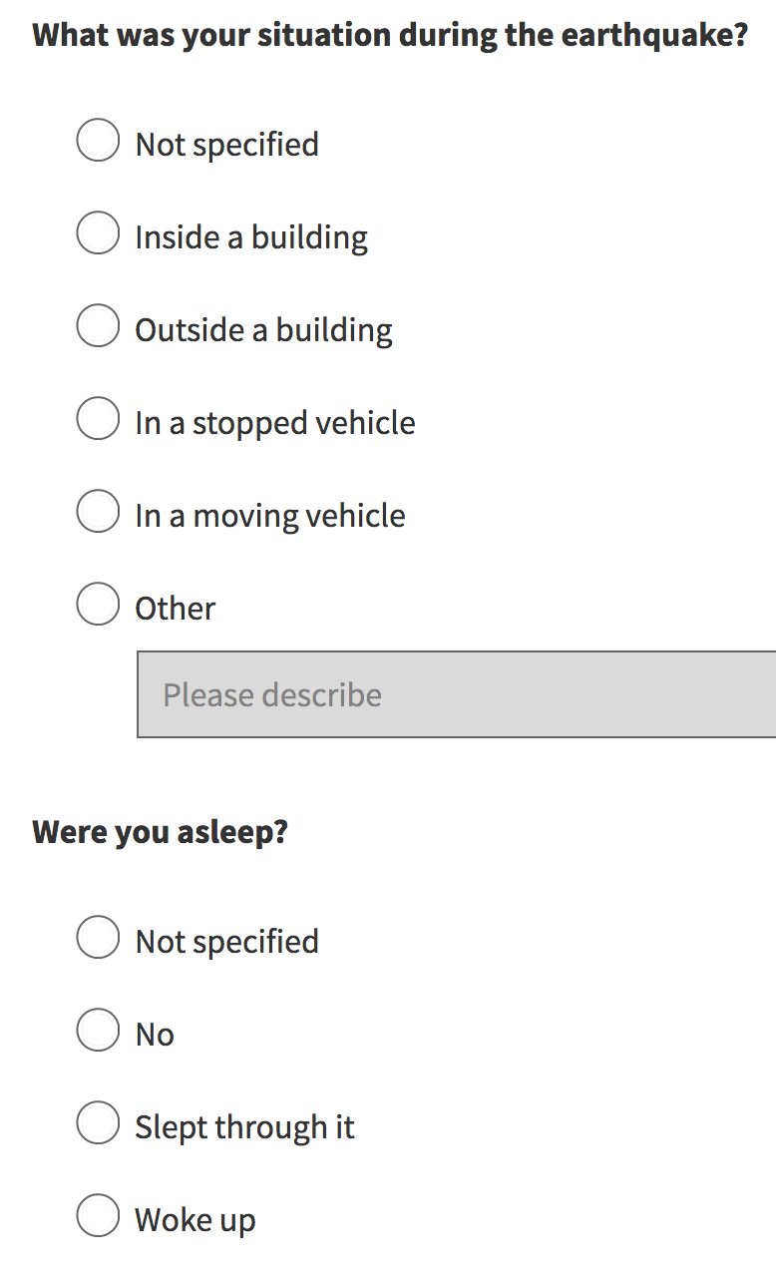
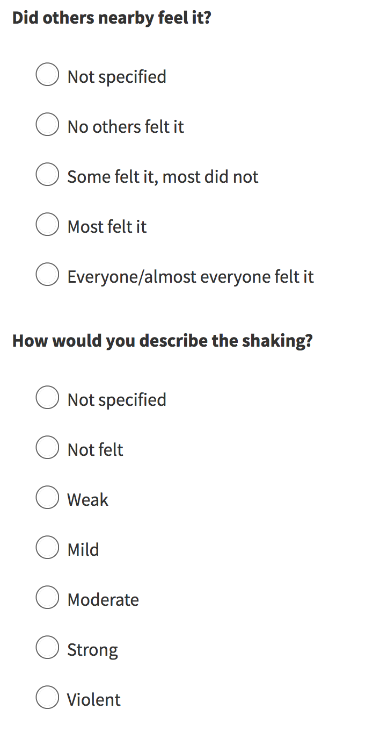
A decision tree is used to calculate CDI from
these reports. CDI = Community Decimal Intensity
Did You Feel It?
https://earthquake.usgs.gov/earthquakes/eventpage/unknown#tellus

